Slide 1
The Church of Jesus Christ of Latter-day Saints
(Mormons)

Slide 2
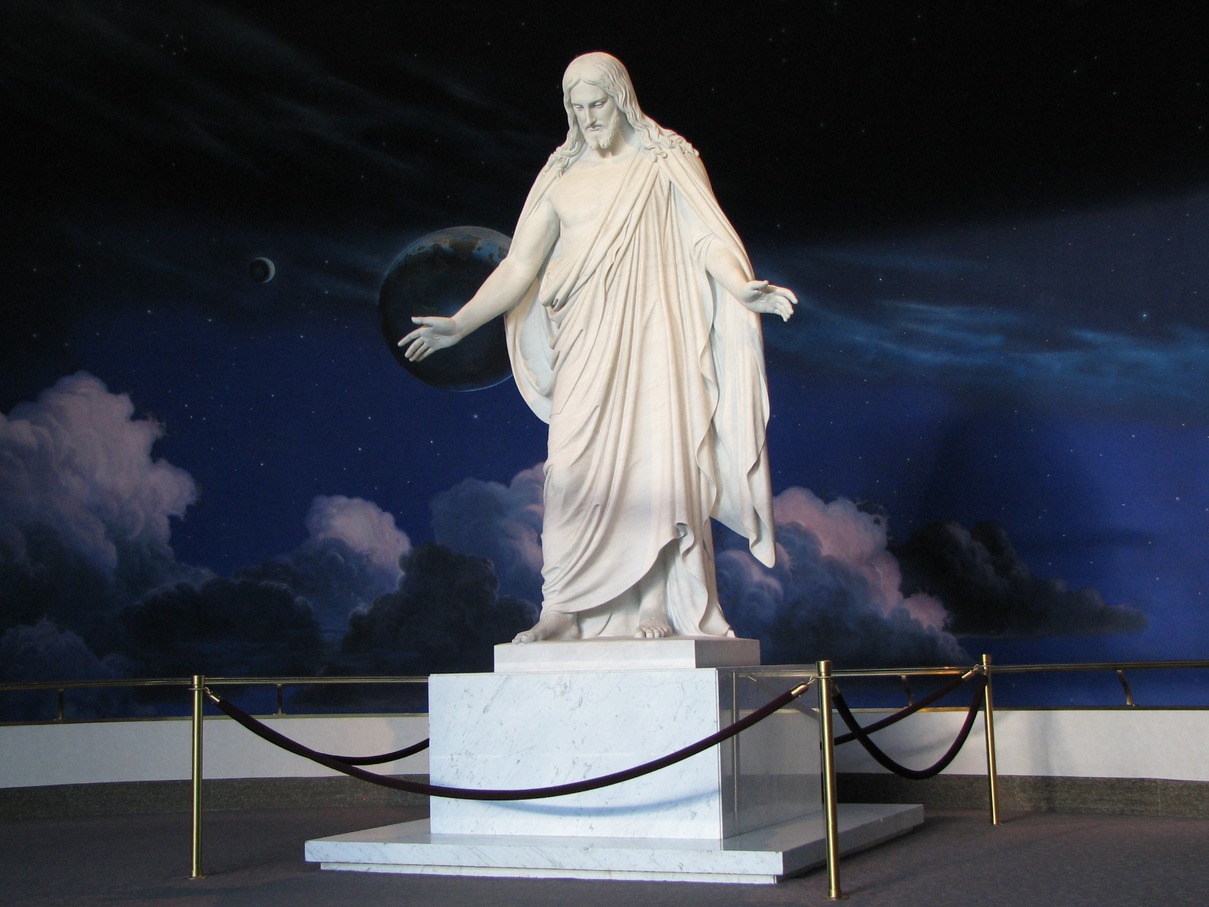

Slide 3
Members of the Church of Jesus Christ of Latter-day Saints are often nicknamed “Mormons”

Slide 4
The Church of Jesus Christ of Latter-day Saints was formally organized on April 6, 1830 in Fayette, New York, United States

Slide 5
Church doctrine is summarized in the 13 Articles of Faith

Slide 6
For example, Article 1 states: We believe in God, the Eternal Father, and in His Son, Jesus Christ, and in the Holy Ghost

Slide 7
Mormons are Christians that believe in Jesus Christ
They use the King James version of the Bible

Slide 8
The Church was organized through Joseph Smith which members refer to as a prophet

Slide 9
Joseph Smith said that God the Father and Jesus Christ appeared to him when he asked God which church to join (James 1:5)

Slide 10
Joseph Smith said the angel Moroni appeared to him telling him where the gold plates were buried containing the religious record of ancient inhabitants of America

Slide 11
Joseph Smith said these plates were translated to become The Book of Mormon

Slide 12
Joseph Smith was assassinated by a mob in Carthage, Ohio on June 27, 1844
Mormons believe that Brigham Young was the next prophet chosen to lead them

Slide 13
The Mormons were persecuted because of plural marriage (i.e. marriage similar to Abraham) and their support towards the native Americans

Slide 14
Plural marriage was discontinued in 1890
Anyone that practices this is excommunicated from the Church

Slide 15
American history tells the story of the Mormons migrating and creating settlements from Kirtland, Ohio to Independence, Missouri to Nauvoo, Illinois to Salt Lake City, Utah to escape persecution

Slide 16
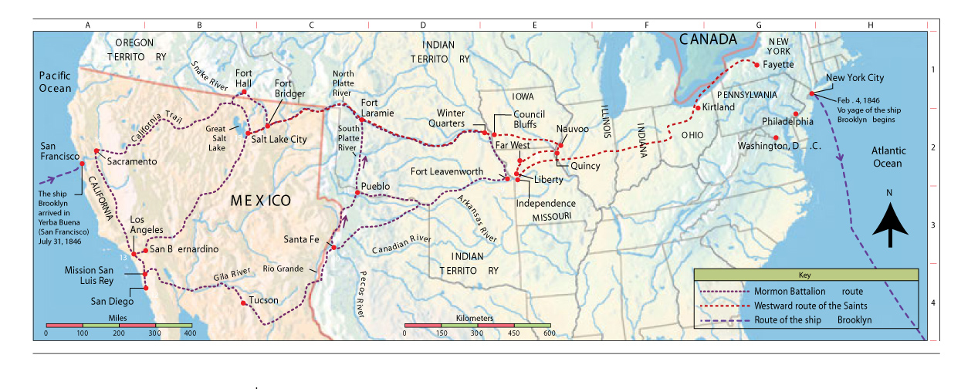

Slide 17
This westward journey was taken by about 70,000 people
Some of the Mormon pioneers pulled handcarts as they walked 1,300 miles

Slide 18
Some of the Mormon pioneers suffered starvation, disease and death
It is estimated about 1,900 Mormons died along the trail

Slide 19
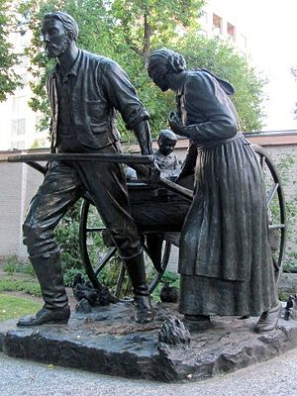
Statute Commemorating Pioneers in Utah - July 24, 1847

Slide 20
Following is a map showing the westward exodus of the Mormons between 1846 to 1869
This map also shows the Mormon Battalion route and the path followed by the handcart companies to the Mormon Trail

Slide 21
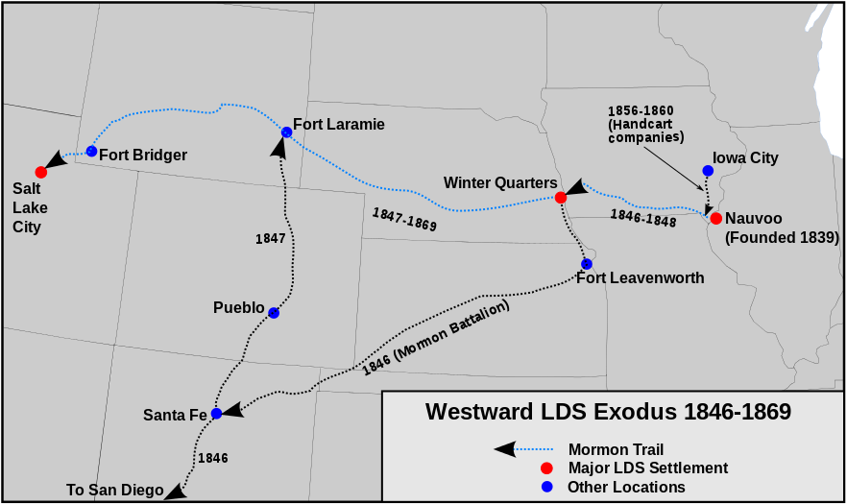

Slide 22
Today it is called the American Exodus
You can explore the Mormon Pioneer National Historic Trail across five states to see the route 70,000 Mormons traveled from 1846 to 1869 to escape religious persecution

Slide 23
Mormon Pioneer Historic Trail Map and Brochure Download a copy of the official map: http://hfc.nps.gov/carto/PDF/MOPImap1.pdf

Slide 24
Mormons believe that “families can be together forever” meaning after death
Faithful Mormons attend a nearby temple

Slide 25
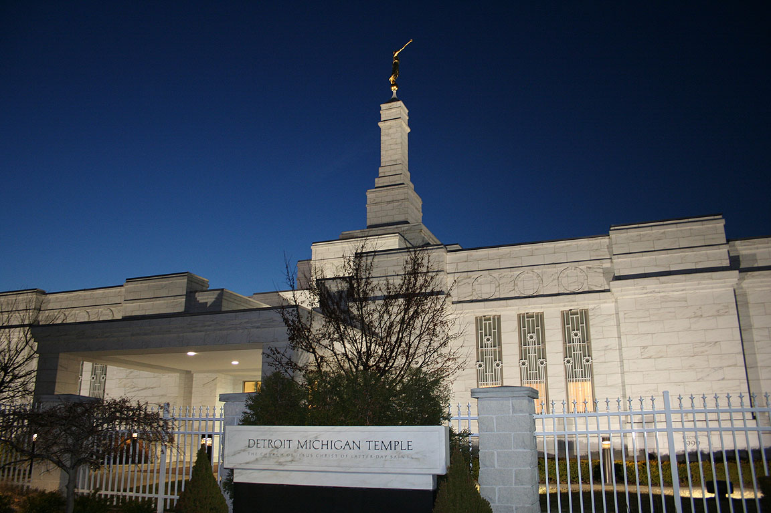

Slide 26
Today there are prominent Mormons in such fields as government, literature, art, entertainment, sports, news & radio

Slide 27
Gladys Knight, Singer
Jabari Parker, NBA Basketball Player
“Ziggy”, Ezekiel Ansah, NFL Player, Detroit Lions
Glenn Beck, Blaze TV-Radio Show Host

Slide 28
Harry Reid, Democrat, Nevada Senator
Mitt Romney, former Republican Presidential Candidate
Lindsey Sterling, Singer/Violinist

Slide 29
Alex Boye, Singer
Danny Ainge, NBA Player, Boston Celtics General Manager
Richard Paul Evans, Author of The Christmas Box

Slide 30

Meet the Mormons is a Documentary

